Slide 1
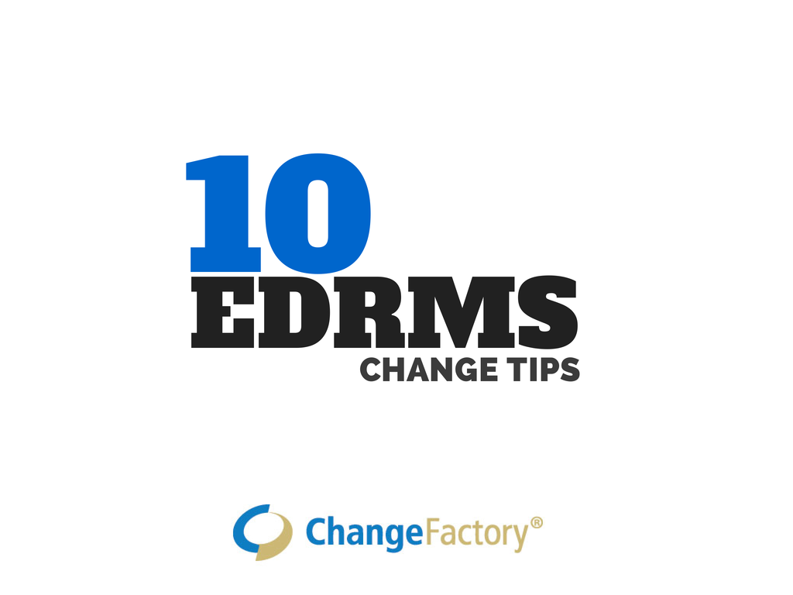

Slide 2
The level of EDRMS adoption achieved is dependent on having people’s behaviours and knowledge be the focus of the change.

Slide 3
The level of EDRMS adoption achieved is dependent on promoting a proactive rather than reactive approach to recordkeeping.

Slide 4
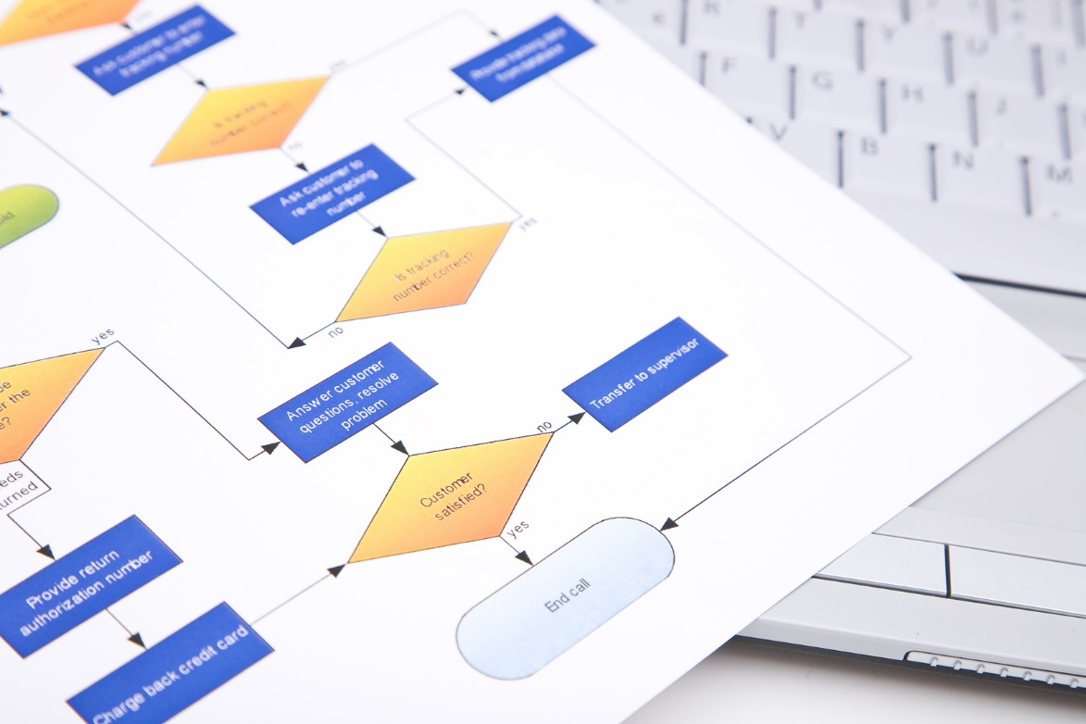
The level of EDRMS adoption achieved is dependent on the level of engagement with the business and the integration with business processes of the EDRMS.

Slide 5
Let the business needs drive your records management processes within a recordkeeping framework, rather than adapting business process to recordkeeping requirements.

Slide 6
If EDRMS project sponsors disbelieve the notion that high levels of EDRMS adoption will increase productivity, the project will fail.

Slide 7
Focusing on removing blockers and strengthening motivators to change and improving the capability of users and supporting teams dramatically increases user adoption rates.

Slide 8
Resistance to change in EDRMS projects often stems from lack of executive support…
…and myths and stories about the EDRMS and lack of capability within individuals and teams.

Slide 9
Adoption target
The level of EDRMS adoption achieved is dependent on using experiential learning methods rather than just telling people what to do.

Slide 10
An EDRMS is different from IT projects.
Users can, and will,
avoid using the EDRMS
where possible.
You have to create an environment where they decide to use it in preference.

Slide 11
Protect your information assets with an information governance framework.

Slide 12
www.changefactory.com.au

